Slide 1
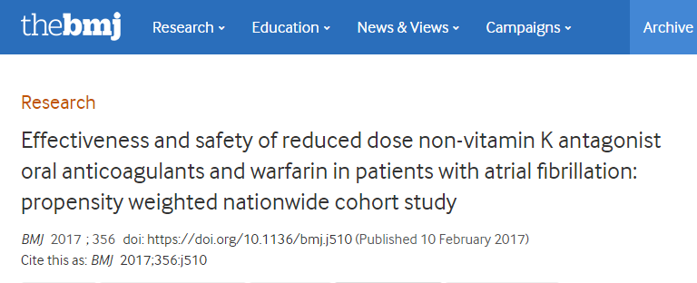

Slide 2
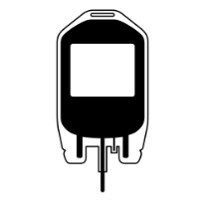


The study examines clinical effectiveness and safety of Apixaban 2.5 mg, Dabigatran 110 mg, and Rivaroxaban 15 mg compared with warfarin among patients with atrial fibrillation who had not previously taken an oral anticoagulant
Outcomes
Primary effectiveness outcome of ischemic stroke/systemic embolism
Principal safety outcome of any bleeding events
Methods
Nationwide cohort study using individual linked data from three nationwide registries in Denmark
Propensity weighted (inverse probability of treatment weighted)
Patients
N=2099; Dabigatran, n=467; Rivaroxaban, n= 669; VKA, n=963
Mean follow-up = 21.7 ± 13.4 months
Patients in Queen Mary Hospital, Hong Kong, (Jan 2008 to Dec 2014), were identified via the computerized database of the clinical management system
Limitations
While inverse probability treatment weighting allows for causal inference on average treatment effects, it is likely that some unmeasured residual confounding and selective prescribing behavior were still present
Specifically, quality of treatment in associations with social status and socioeconomic factors could have contributed to differences in outcomes associated with treatments
*Included studies listed in slide notes
Notes:
Reference
Carmo J et al. Thromb Haemost 2016;116:745–63
Included studies
Ho JCS et al. Clin Cardiol 2012;35:40–5
Larsen TB et al. J Am Coll Cardiol 2013;61:2264–73
Larsen TB et al. Am J Med 2014;127:329–36
Larsen TB et al. Am J Med 2014;127:650–6
Vaughan Sarrazin MS et al. Am J Med 2014;127:1179–85
Graham DJ et al. Circulation 2015;131:157–64
Ho CW et al. Stroke 2015;46:23–30
Hernandez I et al. J Am Med Assoc Intern Med 2015;175:18–24
Bouillon K et al. Lancet Haematol 2015;2:e150–e159
Lauffenburger JC et al. J Am Heart Assoc 2015;4:e001798
Abraham NS et al. Br Med J 2015;350:h1857
Chang HY et al. Br Med J 2015;350:h1585
Yap LB et al. Clin Appl Thromb Haemost 2015;22:792–7
Maura G et al. Circulation 2015;132:1252–60
Avgil-Tsadok M et al. Thromb Haemost 2015;115:152–160
Chan PH et al. Heart Rhythm 2016;13:366–73
Seeger JD et al. Thromb Haemost 2015;114:1277–89
Villines TC et al. Thromb Haemost 2015;114:1290–98
Avgil-Tsadok M et al. Circ Cardiovasc Qual Outc 2015;8:593–9
Nishtala PS et al. Int J Cardiol 2015;203:746–52

Slide 3
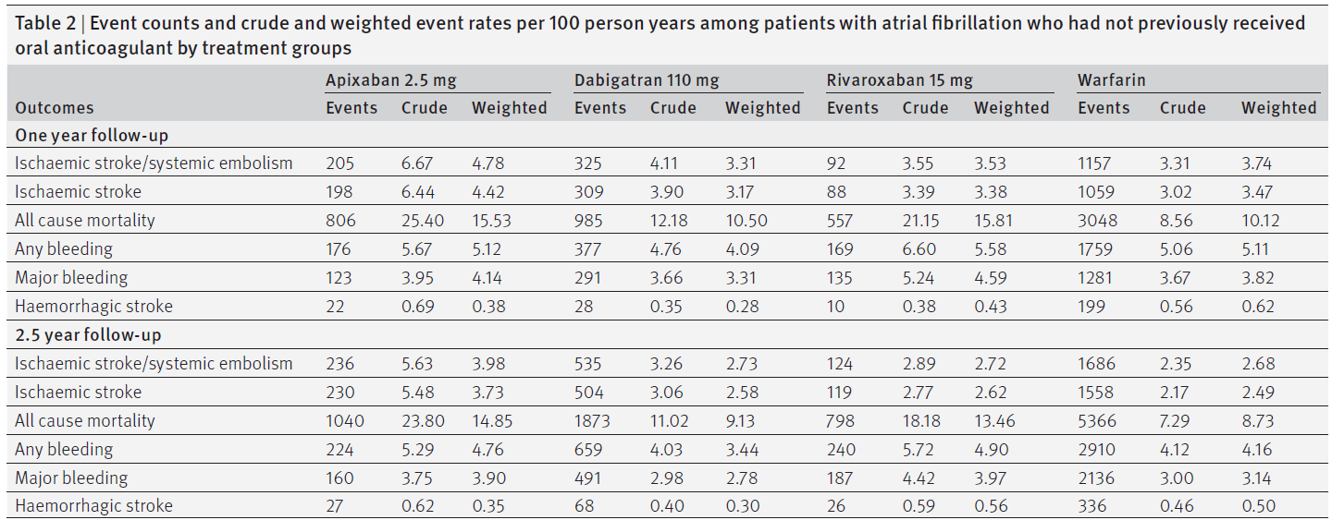
Results – Crude and weighted event rates in each of the low dose NOAC and warfarin arms

Slide 4
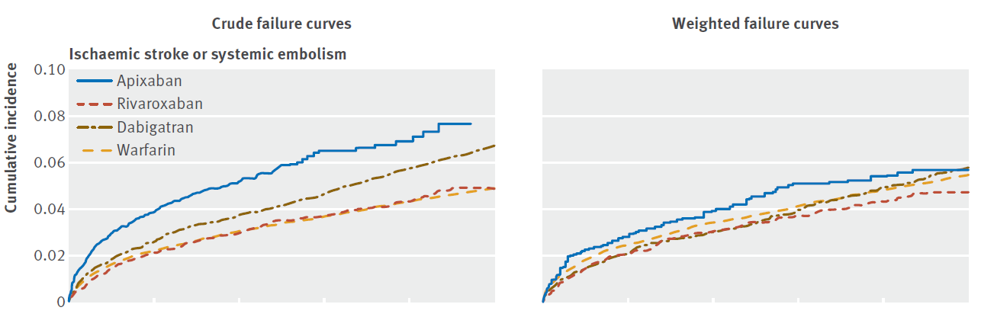
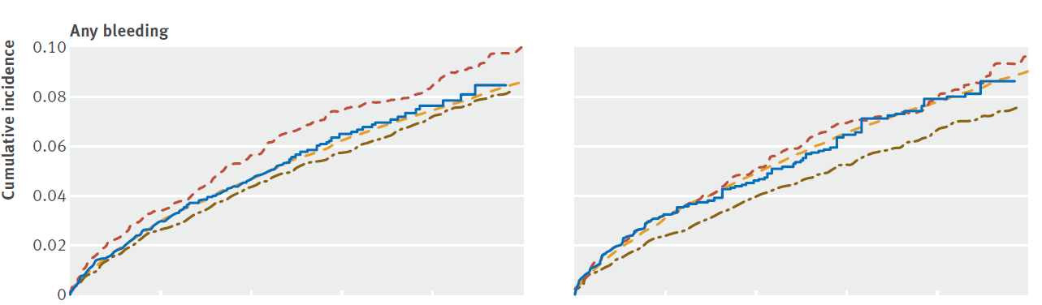
Cumulative risk of events depicted by crude and weighted failure curves in patients with atrial fibrillation according to initiated treatment

Slide 5
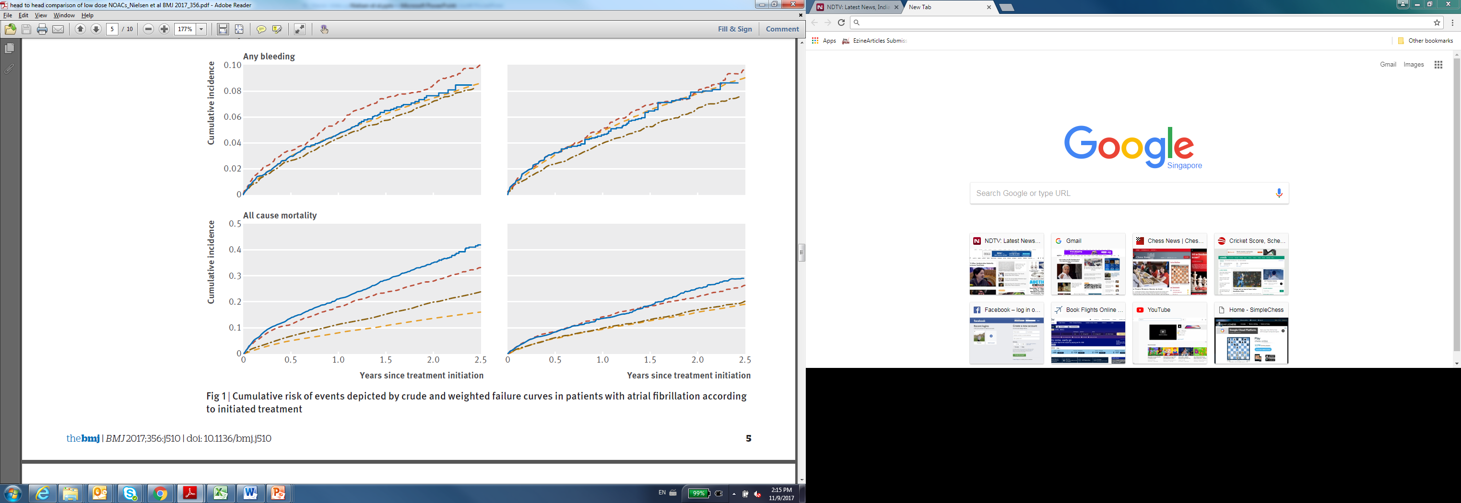
Cumulative risk of mortality depicted by crude and weighted failure curves in patients with atrial fibrillation according to initiated treatment

Slide 6
Limitations of Nielsen et al
While inverse probability treatment weighting allows for causal inference on average treatment effects, it is likely that some unmeasured residual confounding and selective prescribing behavior were still present
Specifically, quality of treatment in associations with social status and socioeconomic factors could have contributed to differences in outcomes associated with treatments.

Slide 7
Conclusion
Rates of ischemic stroke or systemic embolism with apixaban 2.5 mg were higher but not significantly different to those with warfarin
There was a trend towards lower thromboembolic rates with dabigatran 110 mg and rivaroxaban 15 mg, they were not significantly different to rates with warfarin
Rates of bleeding were not significantly different with apixaban and rivaroxaban compared with warfarin but were significantly lower with dabigatran
For the outcome of all cause mortality, apixaban and rivaroxaban was associated with a significantly higher risk (hazard ratios 1.23, 95% confidence interval 1.10 to 1.36, and 1.48, 1.32 to 1.67, respectively). For dabigatran there was no significant difference (0.93, 0.84 to 1.02).

