Slide 1
Dabigatran in Asia
RE-LY Asia analysis and real world evidences from Asia

Slide 2
NOAC vs Warfarin Atrial Fibrillation Studies – Asian representation
 | RE-LY | ROCKET | ARISTOTLE | ENGAGE
Drug | Dabigatran | Rivaroxaban | Apixaban | Edoxaban
Class | DTI | Anti-Xa | Anti-Xa | Anti-Xa
Total number | 18 113 | 14 264 | 18 201 | 21 105
Asian number | 2782 | 932 | 1993 | 1943
Adapted from Europace (2015) 17, ii31–ii39
N Engl J Med 2009;361:1139–51;
N Engl J Med 2011;365:883–91
N Engl J Med 2011;365:981–92
N Engl J Med 2013; 369:2093–104.

Slide 3
RE-LY® Asian population analysis:
Asian patients enrolled in RE-LY^{®1-3}
East Asia 1648
China 541
Hong Kong 90
Japan 326
South Korea 336
Taiwan 355
South Asia 1134
India 578
Malaysia 185
Philippines 157
Singapore 59
Thailand 155
RE-LY ® provides the most comprehensive data on Asian patients with AF (2700 patients vs ARISTOTLE enrolled 1993 Asian patients; ROCKET-AF enrolled just 932*)^{4,5}
Total 2782
*An additional 1280 Japanese patients were enrolled in J-ROCKET, a Phase III trial undertaken in Japan to assess the efficacy and safety of a reduced dose of rivaroxaban, 15 mg OD, vs dose-adjusted warfarin
1. Connolly SJ et al. N Engl J Med 2009;361:1139–51; 2. Hori M et al. Stroke 2013;44:1891–96; 3. Chiang CE et al. Thromb Haemost 2014;111:789–97; 4. Granger CB et al. N Engl J Med 2011;365:981–99; 5. Patel MR et al. N Engl J Med 2011;365:883–91;
Notes:
2782 Asian patients were enrolled in the RE-LY® trial, representing a considerable proportion of the total trial population. The RE-LY® trial investigated anticoagulation in a larger number of Asian patients compared with the ARISTOTLE trial, which enrolled 1993 Asian patients, and the ROCKET-AF trial, which enrolled just 932 Asian patients.
Within the RE-LY® trial, 10 Asian countries were represented, from both East and South Asia.
References
Connolly SJ et al. N Engl J Med 2009;361:1139–51; Hori M et al. Stroke 2013;44:1891–96; Chiang CE et al. Thromb Haemost 2014;111:789–97; Granger CB et al. N Engl J Med 2011;365:981–99; Patel MR et al. N Engl J Med 2011;365:883–91;

Slide 4
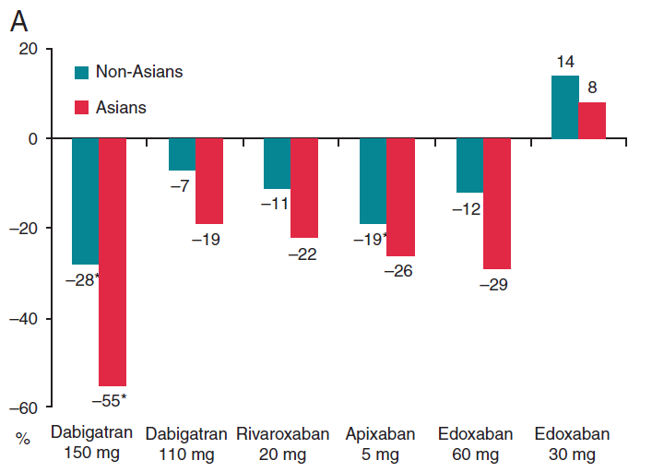
Systemic stroke/embolization events
Relative
Risk
Reduction
* p<0.05
Europace (2015) 17, ii31–ii39

Slide 5
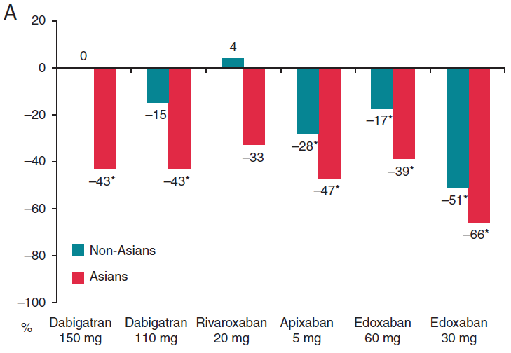
Major bleeding events
Relative
Risk
Reduction
* p<0.05
Europace (2015) 17, ii31–ii39

Slide 6
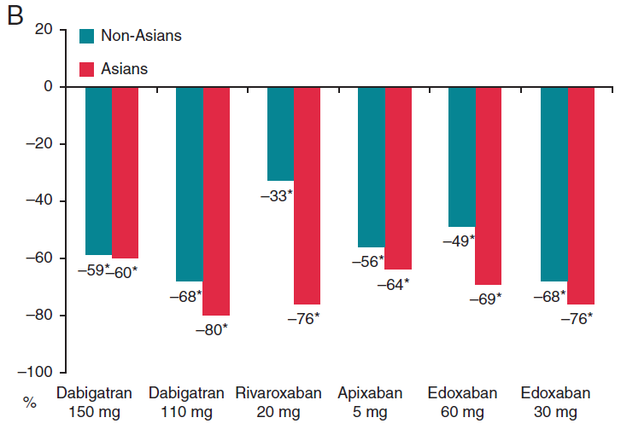
Intracranial haemorrhage
Relative
Risk
Reduction
* p<0.05
Europace (2015) 17, ii31–ii39

Slide 7
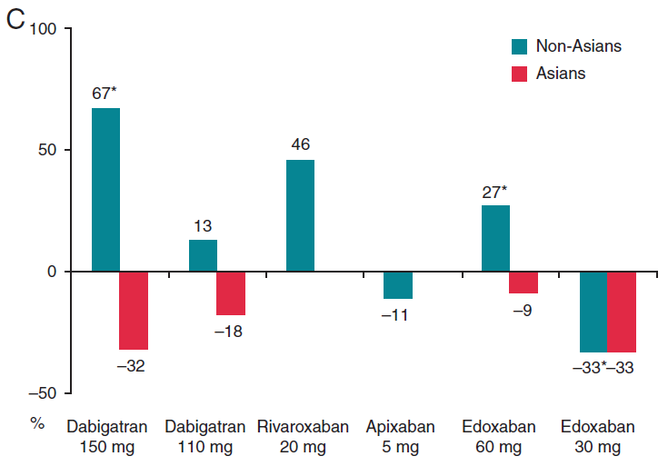
Gastrointestinal haemorrhage
Relative
Risk
Reduction
* p<0.05
Europace (2015) 17, ii31–ii39

Slide 8
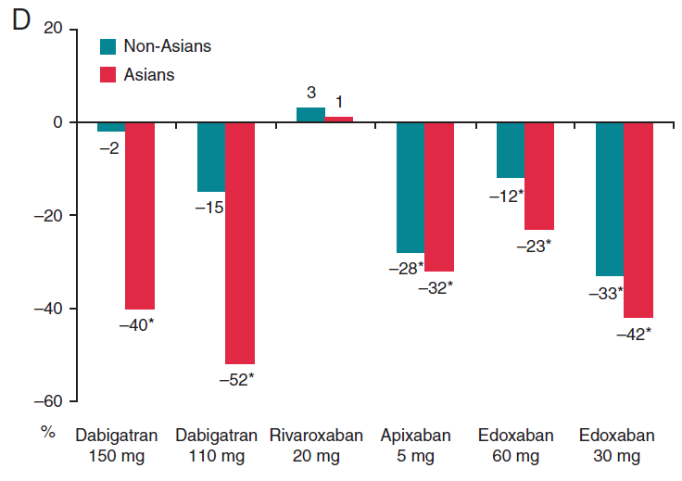
Bleeding from any cause
Relative
Risk
Reduction
* p<0.05
Europace (2015) 17, ii31–ii39

Slide 9
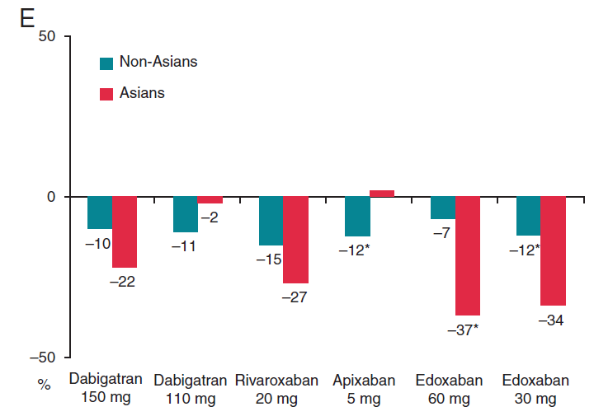
All cause mortality
Relative
Risk
Reduction
* p<0.05
Europace (2015) 17, ii31–ii39

Slide 10
NOACs Real world evidence in Asia

Slide 11
Taiwan health insurance study
Cardiovascular, bleeding, and mortality risks of Dabigatran in Asians with nonvalvular atrial fibrillation Chan Y-H et al. Stroke 2016;47 DOI: 10.1161/STROKEAHA.115.011476

Slide 12
Taiwan health insurance study assessed safety and effectiveness of dabigatran vs warfarin in patients with NVAF
>14 000 OAC-naïve dabigatran or VKA users
Propensity score-weighted
(but see limitations)
Median 0.67 years
follow-up
In Taiwan, the licensed doses for Pradaxa® are: 150 mg BID and 110 mg BID for the prevention of stroke and systemic embolism in adult patients with NVAF
Mean age: 76 years (warfarin), 75 years (dabigatran)
1. Chan Y-H et al. Stroke 2016
Notes:
Reference
Chan Y-H et al. Stroke 2016;47 DOI: 10.1161/STROKEAHA.115.011476

Slide 13
Analysis included older patients, generally with more comorbidities, vs RE-LY®
Characteristics, % | Health insurance database¹ |  | RE-LY^{®2,3}
 | Dabigatran (n=9940)* | Warfarin (n=9913) | Dabigatran 150 mg (n=6076) | Warfarin (n=6022)
Age <65 years | 13 | 12 | 16.4
Age 65–74 years | 29 | 28 | 43.5
Age ≥75 years | 58 | 60 | 40.1
Male | 58 | 58 | 63.2 | 63.3
Hypertension | 87 | 87 | 78.9 | 78.9
Diabetes | 41 | 41 | 23.1 | 23.4
Ischaemic stroke | 33 | 33 | 20.3 | 19.8
TIA | 6 | 6
Heart failure | 16 | 16 | 31.8 | 31.9
MI | 3 | 3 | 16.9 | 16.1
In Taiwan, the licensed doses for Pradaxa® are: 150 mg BID and 75 mg BID for the prevention of stroke and systemic embolism in adult patients with NVAF *44% OAC-naïve; 56% switched from warfarin
1. Chan Y-H et al. Stroke 2016; 2. Connolly SJ et al. N Engl J Med 2009; 3. Eikelboom JW et al. Circulation 2011;
Notes:
Baseline characteristics for the health insurance database are shown after applying propensity scores.
Dabigatran group comprises OAC-naïve dabigatran starters (n=4402) and switchers from warfarin to dabigatran (n=5538).
References
1. Chan Y-H et al. Stroke 2016;47 DOI: 10.1161/STROKEAHA.115.011476 2. Connolly SJ et al. N Engl J Med 2009;361:1139–51; 3. Eikelboom JW et al. Circulation 2011;123:2362–72

Slide 14
Most patients received dabigatran 110 mg BID; patients receiving 150 mg were younger, and more often male, with a lower bleeding and stroke risk
Characteristic | Dabigatran 110 mg BID* | Dabigatran 150 mg BID* | Warfarin
Patients, n | 8772 | 1168 | 9913
Age, years, mean (SD) | 76 (9) | 71 (11) | 76 (10)
Age ≥65 years, % | 88 | 77 | 88
Age ≥75 years, % | 60 | 43 | 60
Male, % | 57 | 66 | 58
HAS-BLED score, mean (SD) | 2.58 (1.00) | 2.48 (1.05) | 2.58 (1.06)
CHA₂DS₂-VASc score, mean (SD) | 4.16 (1.58) | 3.89 (1.59) | 4.16 (1.75)
*Overall, 56% of dabigatran users switched from warfarin, 44% were OAC-naïve; SD, standard deviation
1. Chan Y-H et al. Stroke 2016
Notes:
Baseline characteristics for the health insurance database are shown after applying propensity scores.
Overall dabigatran group (n=9940) comprises OAC-naïve dabigatran starters (n=4402) and switchers from warfarin to dabigatran (n=5538).
The reasons for the relatively low proportion of patients receiving the 150 mg dose of dabigatran are unclear, but may relate to lower body weight in Asians compared with non-Asians, and conservative OAC prescribing practices for a patient population known to be at particular risk of warfarin-related ICH.
Reference
Chan Y-H et al. Stroke 2016;47 DOI: 10.1161/STROKEAHA.115.011476

Slide 15
Reduced risks of ischaemic stroke, death, major bleeding, ICH and MI with dabigatran vs warfarin among new users
Warfarin-naïve users of dabigatran*
Dabigatran vs warfarin |  | HR (95% CI)
Ischaemic stroke |  | 0.69 (0.53–0.90), P=0.006
All-cause mortality |  | 0.56 (0.44–0.73), P<0.0001
Major bleeding** |  | 0.59 (0.41–0.86), P=0.007
GI |  | 1.19 (0.64–2.20), P=0.59
ICH |  | 0.40 (0.24–0.66), P=0.0003
MI |  | 0.43 (0.20–0.92), P=0.031
Favours dabigatran
Favours warfarin
0.10
0.50
1.00
2.00
5.00
HR
*Dabigatran n=4402; data are for both 110 mg and 150 mg doses combined; **All hospitalized major bleeding 1. Chan Y-H et al. Stroke 2016
Notes:
Data from this nationwide Taiwanese register indicate that dabigatran is associated with a positive safety profile vs warfarin among new users.
This figure shows safety and effectiveness outcomes among warfarin-naïve dabigatran (n=4402) and warfarin (n=9913) users. Dabigatran data are for both doses combined; in the overall dabigatran group 88% of patients received the 110 mg dose.
Treatment with dabigatran in warfarin-naïve patients was associated with a lower risk of all-cause mortality, all hospitalized major bleeding ICH, and MI, and a similar risk of GI bleeding, compared with warfarin.
Comparable outcomes were seen among patients switching from warfarin to dabigatran (n=5538; data not shown).
The authors concluded that patients taking dabigatran without previous warfarin experience and those switching to dabigatran from warfarin benefited from dabigatran in both efficacy and safety issues when compared with warfarin.
Reference
Chan Y-H et al. Stroke 2016;47 DOI: 10.1161/STROKEAHA.115.011476

Slide 16
Both doses of dabigatran were associated with a positive safety profile vs warfarin
Dabigatran 110 mg vs warfarin |  | HR (95% CI)
Ischaemic stroke |  | 0.62 (0.52–0.75), P<0.0001
All-cause mortality |  | 0.46 (0.38–0.84), P<0.0001
Major bleeding* |  | 0.61 (0.47–0.78) , P=0.0001
GI |  | 0.99 (0.64–1.52) , P=0.96
ICH |  | 0.47 (0.34–0.65) , P<0.0001
MI |  | 0.74 (0.47–1.18) , P=0.21
Dabigatran 150 mg vs warfarin
Ischaemic stroke |  | 0.61 (0.37–1.00) , P=0.051
All-cause mortality |  | 0.41 (0.23–0.70) , P=0.001
Major bleeding* |  | 0.43 (0.19–0.99) , P=0.047
GI |  | 1.05 (0.29–3.76) , P=0.94
ICH |  | 0.22 (0.06–0.76) , P=0.017
MI |  | 0.20 (0.02–1.69) , P=0.14
All patients**
Favours dabigatran
Favours warfarin
0.10
0.50
1.00
2.00
5.00
*All hospitalized major bleeding; **44% of dabigatran group were OAC-naïve. 1. Chan Y-H et al. Stroke 2016
Notes:
Data from this nationwide Taiwanese register indicate that both doses of dabigatran are associated with a positive safety profile vs warfarin.
This figure shows safety and effectiveness outcomes analysed by dabigatran dose. Most patients (88%) received dabigatran 110 mg. Each dose group includes warfarin-naïve dabigatran users and switchers from warfarin to dabigatran.
Treatment with dabigatran at either dose was associated with a lower risk of all-cause mortality, all hospitalized major bleeding and ICH, and a similar risk of GI bleeding and MI, compared with warfarin. Treatment with dabigatran 110 mg BID was associated with a significantly lower risk of ischaemic stroke compared with warfarin.
The authors concluded that, compared with warfarin, dabigatran 110 mg was associated with a reduced risk of ischaemic stroke, ICH, all hospitalized major bleeding, and all cause mortality in a large Asian cohort. They also note that additional studies enrolling more patients taking dabigatran 150 mg to clarify the possible beneficial profiles over the 110 mg dose in Asian patients are warranted.
Reference
Chan Y-H et al. Stroke 2016;47 DOI: 10.1161/STROKEAHA.115.011476

Slide 17
Taiwan health insurance analysis showed a favourable safety and efficacy profile of dabigatran
Summary
31% reduction in ischaemic stroke in new-users of dabigatran vs warfarin
60% reduction in intracranial bleeding in new-users of dabigatran vs warfarin
Significant reductions in hospitalized major bleeding and mortality in new-users of dabigatran vs warfarin
Similar rates of GI bleeding with dabigatran and warfarin
Results consistent regardless of dabigatran dose and prior VKA use
The results of this non-interventional study should be interpreted with caution
“
our study represents the largest ever examination of the efficacy and safety of low-dose dabigatran
”
1. Chan Y-H et al. Stroke 2016
Notes:
Reference
Chan Y-H et al. Stroke 2016;47 DOI: 10.1161/STROKEAHA.115.011476

Slide 18
Hong Kong registry
Ischemic Stroke and Intracranial Hemorrhage With Aspirin, Dabigatran, and Warfarin Impact of Quality of Anticoagulation Control Ho CW et al. Stroke. 2015;46:23-30. DOI: 10.1161/STROKEAHA.114.006476

Slide 19
Hong-Kong hospital study evaluated the risk of stroke and ICH with dabigatran vs warfarin in patients with NVAF
8754 Chinese patients with NVAF
Mean follow-up of 3.0±3.2 years
No statistical matching of cohorts
Mean age 79.5 years; OAC, oral anticoagulant; VKA, Vitamin K antagonist
Ho et al. Stroke. 2015
Notes:
A real-world study conducted in a single centre in Hong Kong included 8754 patients diagnosed with AF between July 1997 and December 2011. Patients with AF diagnosed after the availability of dabigatran were identified separately.
Patients receiving treatment with dabigatran, warfarin, ASA, or no antithrombotic therapy were included in the analysis. Among those receiving warfarin, TTR was recorded and classified into quartiles.
Statistical matching methods were not used in this study.
Patient follow-up was an average of 3 years (mean 3.0±3.2 years).
Ho CW et al. Stroke. 2015;46:23-30

Slide 20
Hong-Kong hospital registry
Observational study
Hospital-based AF registry
(Queen Mary Hospital in HK)
Comparison of (hospital admission for) ischemic stroke and ICH
Patients with AF diagnosed after the commercial availability of dabigatran were also identified (total of 8754)
1428 patients on warfarin
3600 patients on aspirin
393 patients on dabigatran
3333 patients on no antithrombotic therapy
Mean follow up: 36 months

Slide 21
Dabigatran was associated with the lowest incidence of ischaemic stroke
Warfarin (quartiles of TTR)
 |  | HR (95% CI)
ASA |  | 0.73 (0.67–0.81)
Q1 |  | 0.71 (0.58–0.87)
Q2 |  | 0.56 (0.45–0.69)
Q3 |  | 0.42 (0.33–0.53)
Q4 |  | 0.31 (0.23–0.40)
Dabigatran |  | 0.20 (0.12–0.34)
Warfarin (quartiles of TTR)
Decreased risk of stroke
Increased risk of stroke
Ho et al. Stroke. 2015
0.1
1
1.1
Notes:
The study found that dabigatran was associated with the lowest annual incidence of ischaemic stroke (~2% per year), and the lowest risk when compared with no antithrombotic therapy.
After a mean follow-up of 3.0±3.2 years 23.8% of patients had experienced an ischaemic stroke. Patients who received no antithrombotic therapy had the highest incidence of ischaemic stroke (10.38%/yr), followed by those on aspirin (7.95%/yr). Among patients receiving warfarin, the annual incidence of ischemic stroke decreased progressively with increasing TTRs, from about 7% per year in Q1 to about 3% per year in Q4.
Further analysis compared patients on dabigatran with those on warfarin with TTR≥70%. Despite comparable age and CHA2DS-VASc scores, the risk of ischaemic stroke remained significantly lower in dabigatran patients (HR: 0.31; 95% CI 0.15–0.66).
TTR quartiles were categorized as follows: Q1 <17.9%; Q2 ≥17.9% to ≤38.8%; Q3 >38.8% to ≤56.2%; Q4 >56.2%
Ho CW et al. Stroke. 2015;46:23-30

Slide 22
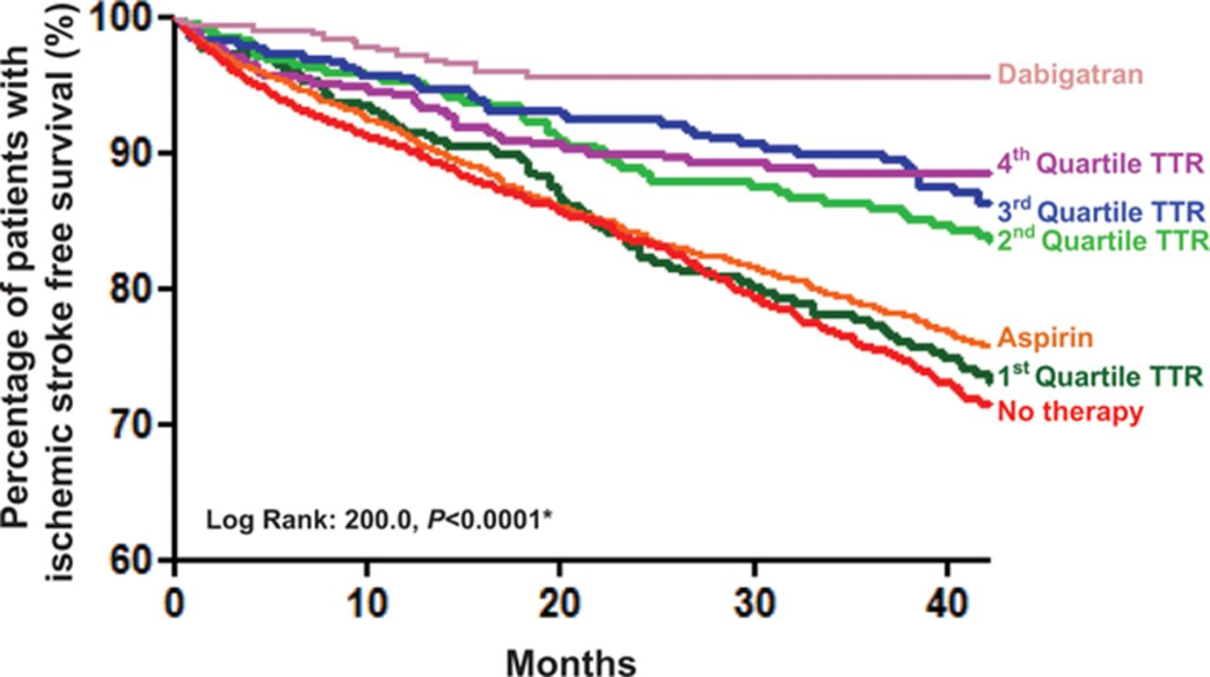
Kaplan-Meier Estimates of ischemic stroke-free survival
Further analysis comparing patients on warfarin with TTR ≥70% (n=154) and patients on dabigatran, despite comparable CHA2DS2-VASc (4.10±1.53 vs. 4.12±1.49) and age (73.8±9.2 vs. 74.5±9.5), the risk of ischemic stroke in patients on dabigatran remained lower than of patients on warfarin with TTR ≥70%
(HR, 0.31; 95% CI, 0.15–0.66)

Slide 23
Dabigatran was associated with the lowest incidence of ICH
 |  | HR (95% CI)
ASA |  | 1.43 (0.97–2.09)
Q1 |  | 2.40 (1.39–4.14)
Q2 |  | 1.49 (0.80–2.77)
Q3 |  | 1.40 (0.77–2.57)
Q4 |  | 1.29 (0.69–2.41)
Dabigatran |  | 0.79 (0.19–3.31)
Warfarin (quartiles of TTR)
Decreased risk of ICH
Increased risk of ICH
Ho et al. Stroke. 2015
0.1
1.0
4.2
Notes:
Dabigatran was also associated with the lowest incidence of ICH; even less than patients receiving no antithrombotic therapy.
The annual incidence of ICH among patients taking dabigatran was 0.32% per year, while among patients receiving warfarin, the annual incidence of ICH increased progressively with decreasing TTRs, from 0.74% per year in the highest quartile to 1.37% per year in the lowest quartile.
Similar results were found after excluding patients who had experienced prior ICH.
TTR quartiles were categorized as follows: Q1 <17.9%; Q2 ≥17.9% to ≤38.8%; Q3 >38.8% to ≤56.2%; Q4 >56.2%
Ho CW et al. Stroke. 2015;46:23-30

Slide 24
Ischemic Stroke and Intracranial Haemorrhage With Aspirin, Dabigatran, and Warfarin
Results from the HK AF registry add to the accumulating evidence that Dabigatran offers clinical benefits (especially reduction of risk for ischemic stroke and ICH) to Asian patients with AF
✓
In Chinese patients with AF, the benefits of warfarin therapy for stroke prevention and ICH risk are closely dependent on the quality of anticoagulation (TTR level)
With decreasing TTR, the risk of ischemic stroke and ICH increased progressively
✓
Chinese AF patients on warfarin tend to have a poor TTR
In addition, even at the top TTR quartile warfarin was associated with a higher stroke (3.10%/yr. vs. 2.24%/yr.) and ICH risk (0.74%/yr. vs. 0.32%/yr.) than dabigatran
Patients on dabigatran had the lowest annual ischemic stroke risk and the lowest ICH risk among all groups
✓
Notes:
Limitations of the study
1. Study design – the selection of antithrombotic strategies was not in a randomized manner
Registry-based
Single-centre observational
In addition, there is possible residual confounding as patients receiving different treatment as well as patients on warfarin with different TTR level were different from each other such as baseline characteristics.
Despite statistical adjustments, potential impacts of residual confounding can not be completely excluded.
Still, the differences in mean CHA2DS2-VASc among these groups did not differ much (ranging only from 0.3 to 0.6).
2. Although we carefully identified all strokes and ICH by careful examination of hospitalization records, laboratory and imaging results,
patients with a milder form of stroke and ICH who were not hospitalized were not included.

Slide 25
Malaysia registry
A single center experience of the efficacy and safety of dabigatran for SPAF
Yap LB et al.
J Thromb Thrombolysis. 2014 Jul;38(1):39-44. doi: 10.1007/s11239-013-1020-y

Slide 26
A single center experience of the efficacy and safety of dabigatran for SPAF
Retrospective observational study of patients prescribed dabigatran between 2010 and 2013.
510 patients
Median age 68 years
Median CHA2DS2-VASc score was 2
Median HAS-BLED score was 2.
The average follow-up duration of 315 days

Slide 27
A single center experience of the efficacy and safety of dabigatran for SPAF
Observational cohort study
National Health Institute in Malaysia
510 dabigatran users
31% switched from warfarin
60% taking 150 mg BID dose
315 days of follow-up (average)
OBSERVATION
1 haemorrhagic stroke
0 ischaemic strokes
2 major bleeding (GI)
Dyspepsia 4%
Withdrawal 18%
“The rate of occurrences of adverse effects and bleeding were lower than those seen in the RE-LY® trial”

Slide 28
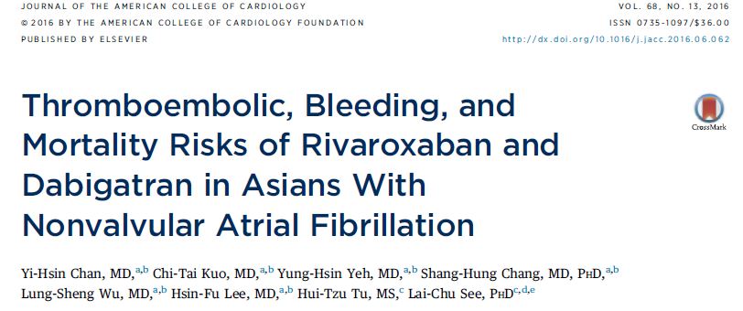
Dabigatran and Rivaroxaban in Taiwan health insurance database

Slide 29
Study background
A nationwide retrospective cohort study was conducted of consecutive patients with NVAF
N = 3916 for Rivaroxaban, N = 5921 for Dabigatran and N = 5251 for warfarin
Consecutive patients between February 1, 2013 and December 31, 2013
The propensity score weighting method was used to balance covariates across study groups
Patients were followed until the first occurrence of any study outcome or the study end date (December 31, 2013).

Slide 30
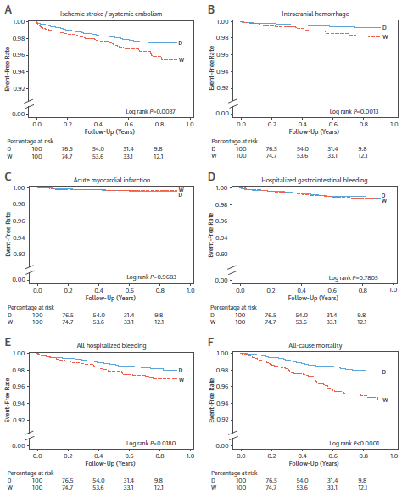
Dabigatran vs warfarin

Slide 31
Dabigatran vs warfarin

Slide 32
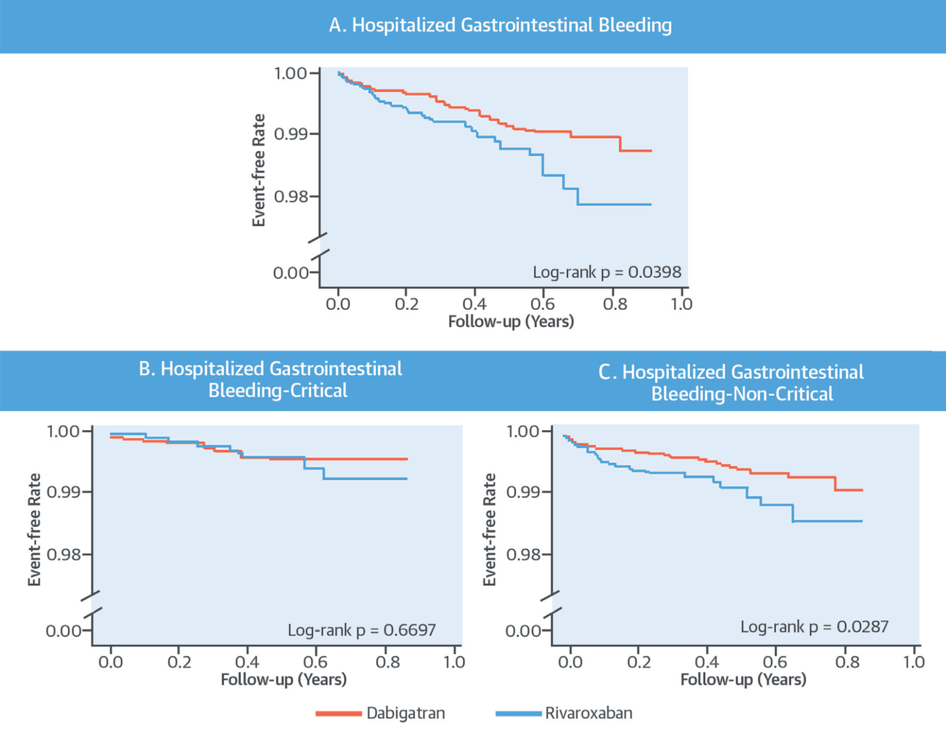
Dabigatran vs Rivaroxaban
Chan YH et al. JACC 2016

Slide 33
SUMMARY
Subgroup analysis of phase III studies comparing Asians against non-Asians show
similar efficacy or even greater efficacy of NOACs in Asians
Similar safety profile of NOACs in Asians with lower risk of GI bleeding
Magnitude of benefit of Dabigatran in reducing ischemic and hemorrhagic stroke was greater in Asian patients.
The real world evidence from Asia reinforce the favorable efficacy and safety profile of Dabigatran compared to warfarin in Asian population

